Slide 1
Application Security .Net
September 9, 2016

Slide 2
Security is TOP focus
Trustworthy Computing
“…for people to be as comfortable using devices powered by computers and software as they are today using a device that is powered by electricity…”
Get Secure – Stay Secure
More information
http://www.microsoft.com/security
http://www.microsoft.com/windows.netserver

Slide 3
Agenda
Code Access Security
Evidence Based Security
Role Based security
ASP.NET Security Overview
Isolated Storage

Slide 4
Code Access Security

Slide 5
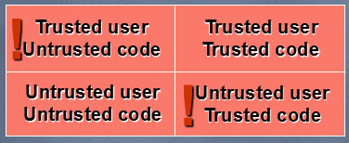
Code Access Security
Things happen when users use code
Need to authorize both users & code
If mismatched, reduce authorization

Slide 6
Code Access Security
Code authorization for managed code
Fine-grained policy
Fine-grained permissions
Multiple levels of trust
Layer of security over O/S
Both security checks always apply
Policy driven based on code evidence
No runtime security decisions by users

Slide 7
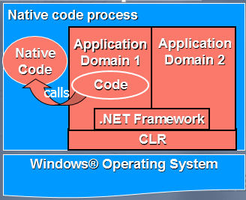
Code Access Security
Managed code in an OS process

Slide 8
Code Access Security: Verification
Security enforceable on well-behaved code
Code exempted only by permission
Code is verified to be memory type safe
only access objects it has references to
only use defined interfaces to objects
also, well-formed metadata and instructions
Verifiability is compiler code gen. issue
VB, C# (except ‘unsafe’) verifiable;
C++ is generally not verifiable

Slide 9
Code Access Security: Default Security Policy
Default Security Policy is installed as part of the .NET Framework
Has default permissions for code access to protected system resources

Slide 10
Code Access Security: Permissions
Permissions can be defined to limit access to system resources.
Use EnvironmentPermission class for environment variables access permission.
The constructor defines the level of permission (read, write,…)

Slide 11
Code Access Security: Deny & Revert Deny
The Deny method of the permission class denies access to the associated resource
The RevertDeny method will cause the effects of any previous Deny to be cancelled

Slide 12
Built-in Permission Classes
DBDataPermission
PrintingPermission
DnsPermission
SocketPermission
WebPermission
UIPermission
SecurityPermission
RegistryPermission
FileIOPermission
PrincipalPermission
MessageQueuePermission
EnvironmentPermission
FileDialogPermission
IsolatedStoragePermission
ReflectionPermission
PublisherIdentityPermission
StrongNameIdentityPermission
ZoneIdentityPermission
SiteIdentityPermission
UrlIdentityPermission

Slide 13
Code Access Security: Permission Sets
A group or collection of permissions
Manipulate a group of permissions with one method call

Slide 14
Code Access Security: Security Exceptions
An exception of type SecurityException is thrown when code attempts to access a protected resource without having the needed permission

Slide 15
Code Access Security: PermitOnly & RevertPermitOnly
Permissions may be granted by code using the PermitOnly method
More permissions may not be granted than is allowed by the current level of trust
The RevertPermitOnly method will cause the effects of any previous PermitOnly to be cancelled

Slide 16
Code Access Security: Demand
Permissions may be demanded before accessing a protected resource using the Demand method
Only the calling components permissions are checked

Slide 17
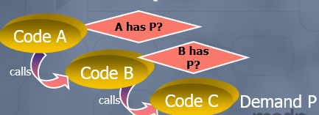
Code Access Security: Stack walk
Demand must be satisfied by all callers
Ensures all code in causal chain is authorized
Cannot exploit other code with more privilege

Slide 18
Code Access Security: Working with Assert
The Assert method can be used to limit the scope of the stack walk
Processing overhead decreased
May inadvertently result in weakened security
CAUTION Use assertions carefully because they can open security holes and undermine the runtime's mechanism for enforcing security restrictions.

Slide 19
Code Access Security: Working with Declarative Security
Code access security can be implemented through attributes
Available on the assembly, class or Method level
Stored as part of the assemblies meta data
Enables use of permview.exe

Slide 20
Demo: Code Access Security
Deny
Demand
Walking the Stack
Declarative Security

Slide 21
Evidence Based Security

Slide 22
Evidence Based Security: Evidence
The CLR examines evidence about code to determine if it is trustworthy
Evidence is presented by an assembly at load time
Location based or identity based
Origin of the assembly, assembly publisher, digital signature….

Slide 23
Evidence Based Security: Code Groups
Assembly evidence is matched against a code group to gain permissions
A code group has 2 attributes
Membership condition
Permission set
An assembly can match more than one code group

Slide 24
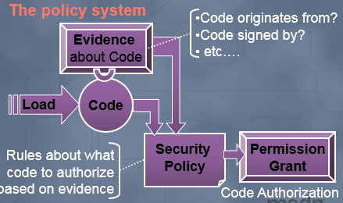
Evidence Based Security: The policy system

Slide 25
Evidence Based Security: Administration Tools
The .Net Framework configuration tool can be used to modify and manage security policy
Mscorcfg.msc - Management Console
The command-line tool caspol.exe can be used to modify and managed security policy

Slide 26
Evidence Based Security: Policy Level Evaluation
Each policy level is evaluated by the CLR to determine an assemblies permissions or level of trust
The least amount of trust from the three policy levels is granted

Slide 27
Evidence Based Security: Code Groups
Each policy level has a set of code groups
Code groups are related hierarchically
There must be at least one code group for each policy level
Once the CLR determines that a code group does not map to an assembly, no dependent code groups are examined

Slide 28
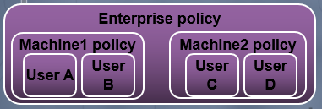
Evidence Based Security: Policy levels
Multiple policy levels for administration
Enterprise: common policy for entire org.
Machine: policy for all users of a machine
User: policy specific to logged in user
Effective policy is the intersection of levels

Slide 29
Evidence Based Security: Code Group Evaluation
More than one code group within a policy level may map to the evidence of an assembly
A policy level has the combination (union) of all code group permissions that map to an assembly
The intersection of policy levels determines permissions granted

Slide 30
Demo: Evidence Based Security
Code Groups
NET Framework Configuration Tool
caspol.exe

Slide 31
Role-Based Security

Slide 32
Role-Based Security
Applications use role-based security to enforce business rule constraints
Individuals are grouped into roles with varying levels of access
.NET role-based security works by making user and role information available to the current thread
Role-based security checks are similar to code access security checks

Slide 33
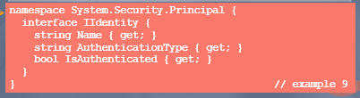
Role-Based Security : Identity
Identity is the combination of an entity’s name and the authentication scheme used to validate it
The Framework implements several Identity classes
WindowsIdentity: Identity = Windows user name
GenericIdentity: General purpose; extension point
FormsIdentity: Used by many ASP.NET applications

Slide 34

Role-Based Security : Principal
Principals are identifiable entities in a secure system
A Principal is the combination of an identity and a set of roles
The Framework implements two Principal classes
WindowsPrincipal: a Windows user and security token
GenericPrincipal: encapsulates a GenericIdentity; adds

Slide 35
Role-Based Security: Principals-based security
Principal-based security checks can be performed through the PrincipalPermission class
Demand() compares the requested permission against Thread.CurrentPrincipal
The PrincipalPermissionAttribute allows for declarative principal security

Slide 36
Role-Based Security: ASP.NET Security: Authentication
ASP.NET can authenticate user credentials using any of the following methods
Windows Authentication: relies on IIS for authentication; ASP.NET typically impersonates the authenticated principal
Forms Authentication: unauthenticated requests are redirected to a login form; cookies are used to cache credentials
Passport Authentication: authentication is delegated to Microsoft Passport servers; Passport ticket is sent back to originating server and used for site access
No Authentication: everyone is allowed access

Slide 37
Role-Based Security: ASP.NET Security: Configuration
ASP.NET configuration files have three sections that pertain to security
Authentication: identifies the authentication mode; provides additional resource information (such as the Forms authentication URL or the Passport redirection URL)
Authorization: specifies which users and roles are allowed or denied access; typically not used with Windows authentication since ACLs address the same problem
Identity: whether or not to use impersonation
Configuration files are arranged hierarchically to provide varying degrees of authorization

Slide 38
Demo: ASP.NET Forms based authentication using roles
ASP.NET configuration files have three sections that pertain to security
Authentication: identifies the authentication mode; provides additional resource information (such as the Forms authentication URL or the Passport redirection URL)
Authorization: specifies which users and roles are allowed or denied access; typically not used with Windows authentication since ACLs address the same problem
Identity: whether or not to use impersonation
Configuration files are arranged hierarchically to provide varying degrees of authorization

Slide 39
Isolated storage

Slide 40
Isolated Storage: Overview of Isolated Security
Allows a trusted assembly to store data on a client machine
Standard file IO operations are not used
Permission to access the local file system not required
Isolated storage handles the physical actual physical location of the data

Slide 41
Isolated Storage: Store
A virtual file system
May have its own folder structure
Files may have data of almost any kind
User data or application state

Slide 42
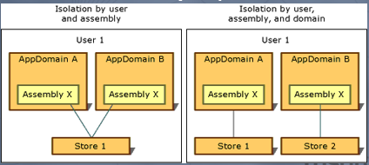
Isolated Storage: Store Scope
Data is kept in a “Store”
Stores are isolated by scope

Slide 43
Demo: Isolated Storage
Writing
Reading
Deleting

Slide 44
Demo: Isolated Storage
Writing
Reading
Deleting

Slide 45

Thank You!
Prashant Kulkarni
Technical Lead
Mobile: +91 9890913122
Desk: +91 20 66046341
Prashant.kulkarni@xoriant.com
www.xoriant.com
India
Mumbai
4th Floor, Nomura
Powai , Mumbai 400 076
Pune
5th Floor, Amar Paradigm
Baner, Pune 411 045
Kolkata
2B, 12th Floor, Tower ‘C’
Rajarhat, Kolkata 700 156
US – Corporate Headquarters
1248 Reamwood Avenue,
Sunnyvale, CA 94089
Phone: (408) 743 4400
343 Thornall St 720
Edison, NJ 08837
Phone: (732) 395 6900
UK
20 Broadwick Street
Soho, London
W1F 8HT, UK
89 Worship Street
Shoreditch,
London EC2A 2BF, UK
Phone: (44) 2079 938 955
Bangalore
4th Floor, Kabra Excelsior,
80 Feet Main Road, Koramangala 1st Block,
Bengaluru (Bangalore) 560034
Gurgaon
A/373rd Floor, Sigma Center
Gurgaon, Haryana 122 011s

